Slide 1
An Application of Large Language Models and Generative Agents to Compare Quality and Quantity Learning Processes and Performance
Workshop 2 presentation for the project Advanced Web Technologies on the topic of Large Language Models for Education: Generative Agents
Mohammad Ferdous Safi | Jasmin Hübler | Siar-Remzi Akbayin
Notes:
Hello everybody, today we are presenting our second presentation on our project, ’An Application of Large Language Models and Generative Agents to compare quality and quantity learning processes and performance'

Slide 2
AGENDA
AGENDA
Recap: Problem statement & Use Case
Demonstration
Further decisions
Roadmap & next Steps
Notes:
First, I‘ll give you a short recap on our problem statement and use case. Then Siar will give you a short presentation of our progress so far, as well as our decisions along the way. Afterwards I will give an outlook with our roadmap and briefly outline our next steps.

Slide 3


RECAP: PROBLEM STATEMENT
If We Could Only Focus On One,
Should Quality or Quantity Be Of More Importance?
PROBLEM STATEMENT & USE CASE > DEMONSTRATION > FURTHER DECISIONS > ROADMAP & NEXT STEPS
Notes:
Our problem statement was structured around one central question - if we can only focus on one, should quality or quantity be of more importance. Our hope was to identify which approach would be more beneficial or effective for, for example, a student studing for an exam.

Slide 4


RECAP: USE CASE
A
Quantity
Quantitative learning process
Evaluation & Discussion
[optional]
Exam
B
Qualitative learning process
Quality
Notes:
To do this we have our simulated learning scenario, where we plan to simulate two groups of student-agents. Group A engages in a quantitative, group B in a qualitative learning process.
Group A, will receive practice questions and answers. They should then ask questions to each other and memorize them.
Group B, should in general research, discuss and understand the underlying material. They will be expected to summarize texts and teach each other the given material as well as their findings.
The goal of both groups is to take an multiple-choice history exam. We will then evaluate them by their score to answer our problem statement. We wanted the groups to have a discussion afterwards, but are pretty sure that it is not possible in the remaining time. We now have it as an optional addition in the back of our minds.
Siar will now show you our progress so far.

Slide 5
Progress
Read papers regarding generative agents and LLMs in general
Get used to LLMs and corresponding tools
Set up dataset with 500 MC-questions and the answers (csv)
Split dataset into chunks and store in FAISS index for similarity search & retrieval with Langchain
Start using Google Colab to overcome local limitations
(max tokens, execution time etc.)

Slide 6
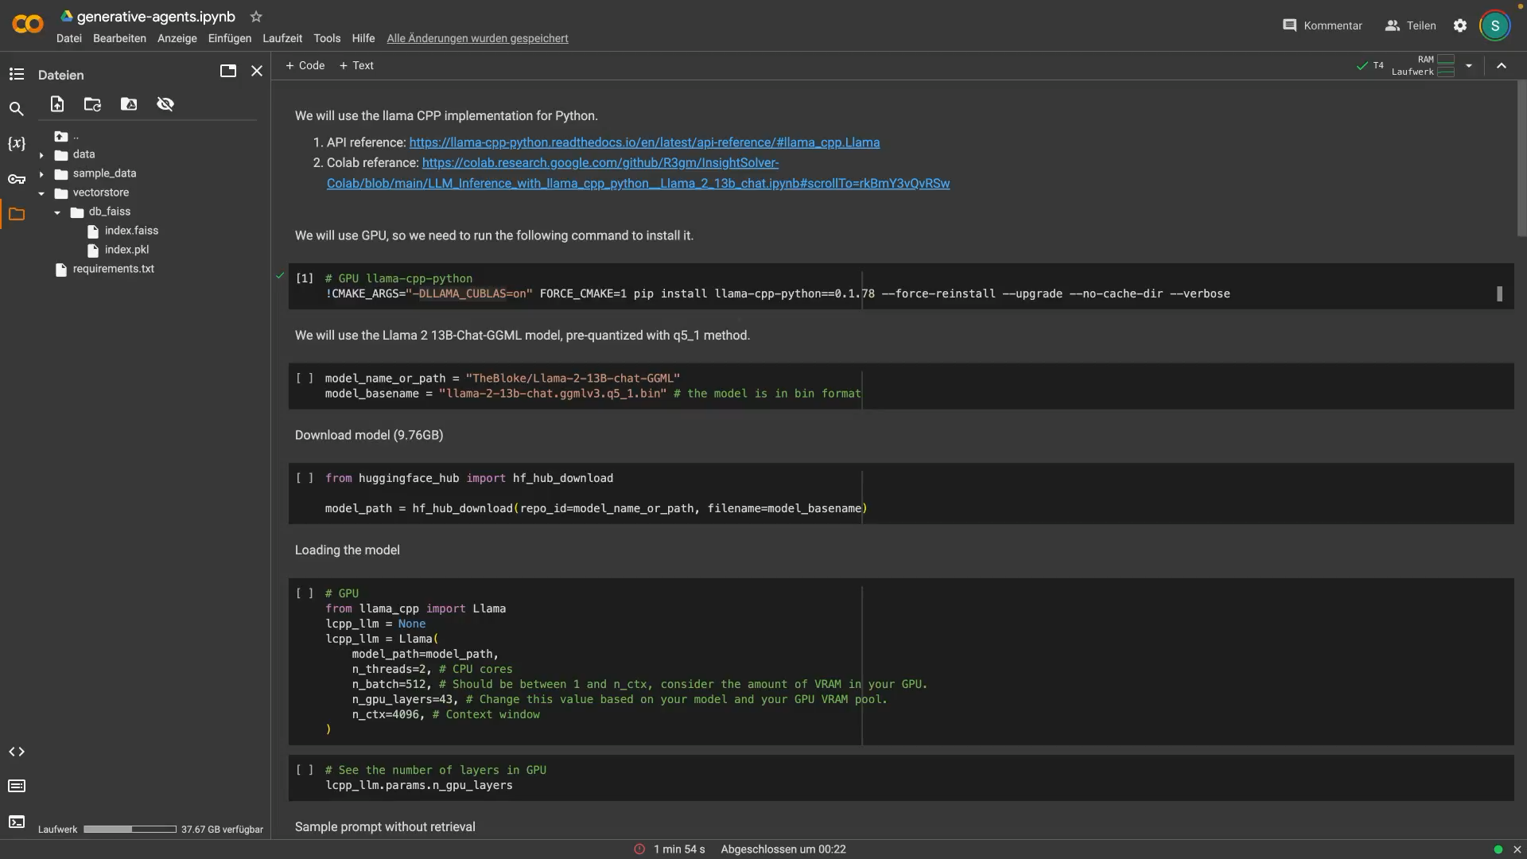
DEMONSTRATION

Slide 7
FURTHER DECISIONS
Lanchain instead of LlamaIndex
Implementation of variation: change sentence structure, the order of answers etc.
Slightly change the use case and compare progress of different characters
Set a specific “learning time” to evaluate efficiency of
learning processes
PROBLEM STATEMENT & USE CASE > DEMONSTRATION > FURTHER DECISIONS > ROADMAP & NEXT STEPS

Slide 8



ROADMAP
Final Submission: 29.02.2024
Research, skill acquisition & start coding
Minimum viable product & start paper
Working prototype
Workshop 1: 16.11.23
Workshop 2: 21.12.2023
Workshop 3: 15.02.2024
PROBLEM STATEMENT & USE CASE > DEMONSTRATION > FURTHER DECISIONS > ROADMAP & NEXT STEPS
Notes:
Now lets look at what comes next. Our next milestone objective is to have a minimum viable product ready for the third workshop as well as having started with the required paper. After that we want to finalize our prototype, have good documentation for it and have a finished paper – all ready to be submitted on the 29th of February.

Slide 9






ROADMAP - NEXT STEPS
Fix bugs with Google colab
Develop and refine agents
Implementing exam service & evaluation
Start paper
PROBLEM STATEMENT & USE CASE > DEMONSTRATION > FURTHER DECISIONS > ROADMAP & NEXT STEPS
Notes:
At the moment we have some problems with Google colab which we want to fix as soon as possible to keep using it for a better experience and performance. Afterwards, our next steps are to further develop, implement and refine the agents with their resources, tools and prompts. We will also implement the exam service as well as the evaluation. Along the way we try to look at our documentation and instructions for usage to keep everything up to date. While doing all this we will need to make decisions according to our progress to not lose focus. We want to prioritize a functional and useful prototype over the exact definitions of our use case and problem statement. We also want to start the paper about our project to ease the stress that will follow in the ending phase of the semester.
And with that I thank you for your attention. See you again in the third workshop.

